Slide 1
Descriptive Analytics
Descriptive analytics is the process of using current and historical data to identify trends and relationships.
Descriptive analytics is the process of parsing historical data to better understand the changes that have occurred in a business.
Using a range of historic data and benchmarking, decision-makers obtain a holistic view of performance and trends on which to base business strategy.
Descriptive analytics can help to identify the areas of strength and weakness in an organization.
Examples of metrics used in descriptive analytics include year-over-year pricing changes, month-over-month sales growth, the number of users, or the total revenue per subscriber.

Slide 2
How does descriptive analytics work?
Descriptive analytics uses various statistical analysis techniques to slice and dice raw data into a form that allows people to see patterns, identify anomalies, improve planning and compare things.

Slide 3
How Is Descriptive Analytics Used?
Companies use descriptive analytics across many parts of the business to evaluate how well they are operating and whether they’re on track to attain business goals.
The metrics produced by descriptive analytics are used in various ways, including:
Reports: The key financial metrics included in a company’s financial statements are generated by descriptive analytics. Other common reports also use descriptive analytics to highlight aspects of business performance.
Visualizations: Displaying metrics in charts and other graphic representations can more efficiently communicate their impact to a wider audience.
Dashboards: Executives, managers and other employees may use dashboards to track progress and manage their daily workload. Dashboards present a selection of KPIs and other important information tailored to the needs of each person. The information may be represented as charts or other visualizations to enable people to absorb it more quickly.

Slide 4
EXAMPLES OF DESCRIPTIVE ANALYTICS
1. Traffic and Engagement Reports
One example of descriptive analytics is reporting. If your organization tracks engagement in the form of social media analytics or web traffic, you’re already using descriptive analytics.
These reports are created by taking raw data—generated when users interact with your website, advertisements, or social media content—and using it to compare current metrics to historical metrics and visualize trends.

Slide 5
2. Financial Statement Analysis
Another example of descriptive analytics is financial statement analysis. Financial statements are periodic reports that detail financial information about a business and, together, give a holistic view of a company’s financial health.
3. Demand Trends
Descriptive analytics can also be used to identify trends in customer preference and behavior and make assumptions about the demand for specific products or services.
Streaming provider Netflix’s trend identification provides an excellent use case for descriptive analytics. Netflix’s team—which has a track record of being heavily data-driven—gathers data on users’ in-platform behavior. They analyze this data to determine which TV series and movies are trending at any given time and list trending titles in a section of the platform’s home screen.

Slide 6
Association rule learning?
Association rule learning is a type of unsupervised learning technique that checks for the dependency of one data item on another data item and maps accordingly so that it can be more profitable. It tries to find some interesting relations or associations among the variables of dataset. It is based on different rules to discover the interesting relations between variables in the database.

Slide 7
The association rule learning is one of the very important concepts of machine learning, and it is employed in Market Basket analysis, Web usage mining, continuous production, etc. Here market basket analysis is a technique used by the various big retailer to discover the associations between items. We can understand it by taking an example of a supermarket, as in a supermarket, all products that are purchased together are put together.

Slide 8
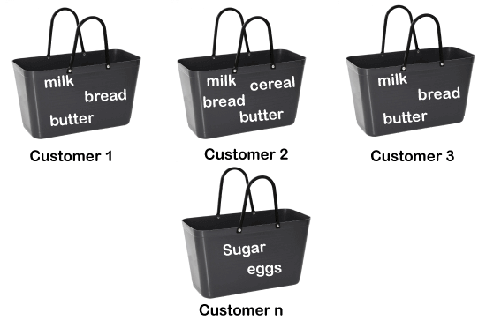
For example, if a customer buys bread, he most likely can also buy butter, eggs, or milk, so these products are stored within a shelf or mostly nearby. Consider the below diagram:

Slide 9
Association rules begins with transactions including one or more products or service providing and some rudimentary data about the transaction. For the goals of analysis, the products and service providing are known as items.
These transactions have been used to contain only the items buy. It can use data like the date and time and whether the users paid with cash or a credit card.

Slide 10
Every transactions provides us data about which products are buy with which other products. This is displayed in a co-appearance table that tells the multiple times that some pair of products was purchased together.
These observations are an instances of associations and can suggest a formal rule like such as if a user buy soda, then the user also buy orange juice. In the data, two of the five transactions contains both soda and orange juice. These two transactions provides the rule. The support for the rule is two out of five or 40 percent.

Slide 11
Because both the transactions that include soda also include orange juice, there is a large degree of confidence in the rule as well. Because two of the three transactions that includes soda also includes orange juice, therefore the rule “if soda, then orange juice” has a confidence of 67 percent. The inverse rule, “if orange juice, then soda,” has a lower confidence.

Slide 12
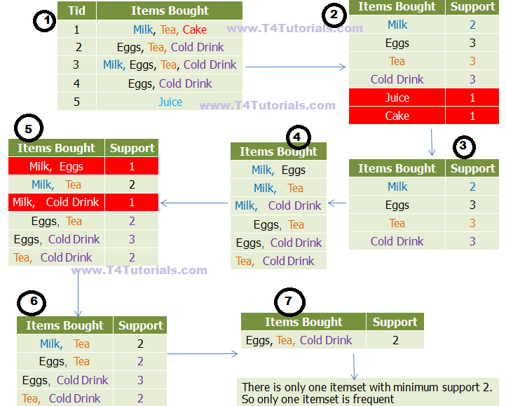
Association rule – Apriori Algorithm

